Slide 1
HUSSAIN JAMEEL

Slide 2
Hello everyone! My name is HUSSAIN. I am excited to share a little about myself, my journey, and what I’ve learned during this course. This presentation reflects who I am and where I aim to go in the future
Introduction :

Slide 3
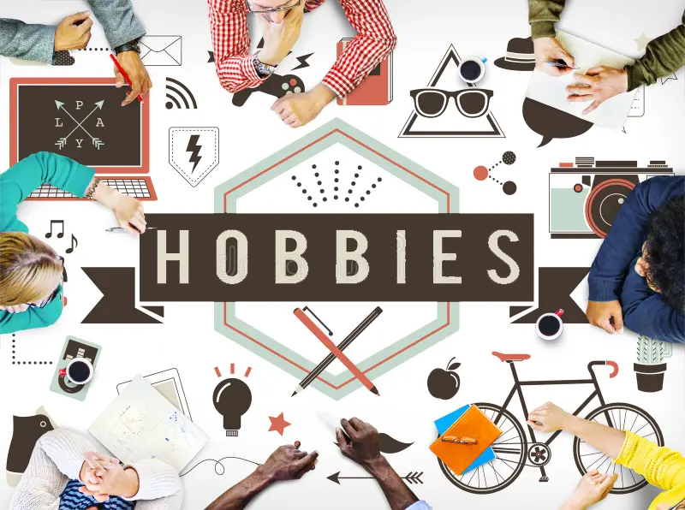
Personality Traits: I would describe myself as: Hardworking – I always try my best in everything I do. Curious – I love learning new things and exploring different ideas. Responsible – I take my duties seriously and complete tasks on time. Team Player – I enjoy working with others and learning from them
Hobbies & Interests
In my free time, I like to:
Read books and articles to gain knowledge
Watch documentaries and educational videos
Listen to music or play outdoor games
Explore new tools and technologies online

Slide 4

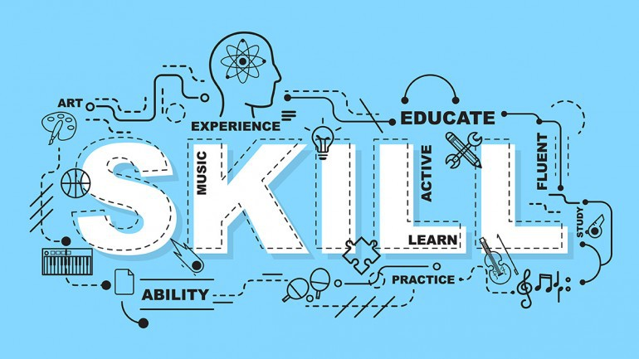
Academic/Personal Achievements
Some of my proud achievements include:
Successfully completed my course with good grades and improved my overall academic performance.
Participated in class projects and group presentations, which helped me build confidence and teamwork skills.
Received positive feedback from teachers for my dedication, regular attendance, and active participation in class activities.
Skills Learned in This Course
During this course, I have gained many useful skills, such as:
Communication and presentation skills
Time management and teamwork
Basic understanding of digital tools and technologies
Problem-solving and critical thinking

Slide 5

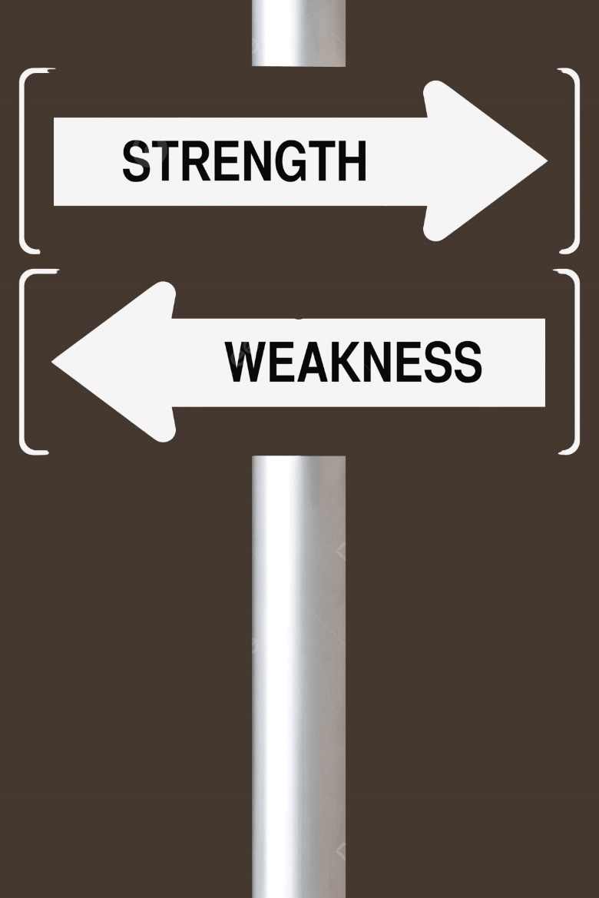
Favorite Topic/Tool My favorite tool is Adobe Photoshop because it allows me to express my creativity and bring my ideas to life. It is a powerful photo editing and graphic design software that helps me edit images, create designs, and enhance visuals with professional quality. I enjoy using Photoshop to adjust colors, remove backgrounds, add effects, and design posters or social media graphics. It is easy to use once you learn the basics and offers endless possibilities for creativity, which is why I find it both fun and useful for my projects.
Strengths & Weaknesses
Strengths:
Quick learner
Good communication skills
Positive attitude
Adaptable to new situations
Weaknesses:
Sometimes overthink decisions
Need to Control Anger

Slide 6
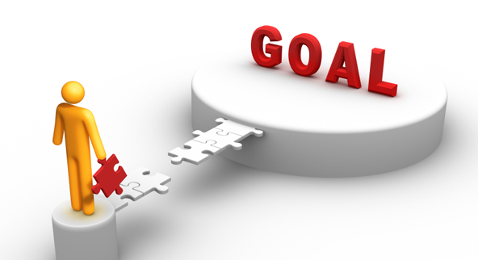
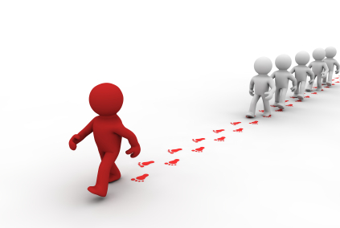
Future Goals
My future goals are:
To continue learning and improving my professional skills
To build a successful career in AI Field
To contribute positively to society and make a difference
9. Role Model/Inspiration
My greatest role model and source of inspiration is Prophet Muhammad (peace be upon him). He was the perfect example of honesty, kindness, patience, and justice. His character teaches us how to live a meaningful and balanced life, treat others with respect, and always speak the truth. Despite facing many challenges, he never gave up and continued to spread the message of peace, love, and equality. I look up to him because his life motivates me to be a better person and to follow the path of goodness and compassion.

Slide 7

10. Closing / Fun Fact Fun Fact: I enjoy experimenting with new tools and learning something new every week — I believe that every skill, no matter how small, can one day make a big difference

Slide 8
Slide Tite
THANK YOU!
FOR BEING A PART OF MY Presentation

